Slide 1
PowerBase for Organizing

Slide 2
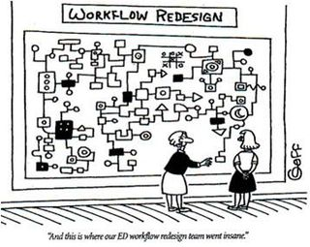
Best Practices: Mapping Your Workflow
To use PowerBase more effectively and efficiently, you can use workflows to ARTICULATE your specific organizing tasks, tactics, and strategies through:
Diagrams
OR
Words Words Words Words Words Words

Slide 3
Use Workflows to:
Articulate your organizing tasks, membership model, fundraising strategy, or daily data entry or followup tasks
Determine you have the information you need to track about your contacts
Provide clarity about the information you need to help you assess the effectiveness of your organizing

Slide 4
Example: Organizer’s Daily Tasks Workflow
Workflow description: Ohio Valley Organizing just finished doing a fundraiser and organizers need to add or update existing contacts with contact information, contributions, relationships, and followup activities:
Does contact exist?
No
Add Contact
Need to do Followup?
Record and Schedule followup phone call in 2 days
Yes
Yes
Add Relationships
Add Contributions
No
More contacts?
No
Yes
Done!

Slide 5
Example: Organizer’s Daily Tasks Workflow cont’d
Consistently capture meaningful information at all stages of your workflow
Are you entering necessary contact info, the ‘category’ or type of contact, their interests, the date and how they came to your organization, the staff responsible, etc.?

Slide 6
Example: Event Turnout Workflow
Workflow description: Ohio Valley Organizing will be holding a meeting to talk to people interested in their library campaign at the end of the month. Organizer will want to register people they know who are interested, and make calls to invite them to the event. During the event, they will have attendees sign in. After the event, lead organizers will want to see the outcome of the event.
Each organizer will:
Program lead will create the event
Identify people interested in the issue
Register interested people for the event
Call people to invite to event and record responses
Up until event, will make up to 3 calls to get people to attend and update respsonses
Either Create list of potential attendees OR create blank sign sheet
Collect information about attendees on sign in sheet
Assess outcome of event and turnout strategy
Etc…

Slide 7
Example: Event Turnout Workflow cont’d
Consistently capture meaningful information at all stages of your workflow
Are you able to gather additional information from participants about interests, volunteer potential, or issues you need to followup?

