Slide 1
PowerBase Webinar: Using Campaigns & Surveys
For Audio call: 1.866.740.1260; access code 7242600#
Alice Aguilar
Program Director

Slide 2
CAMPAIGN
Meetings
Responses to surveys
contributions
Phone calls
Please renew your membership
Event participation
memberships
Activities

Slide 3
CiviCampaign lets you link together different activities under one "umbrella" so that you can track the progress of all your efforts towards one programmatic goal or campaign.

Slide 4
Campaigns allow you to:
connect related activities
create surveys for use with walklists and phonebanking
create online petitions (aka online survey)
Review responses from surveys and petitions

Slide 5
Preparing to use Campaigns in PowerBase
Know your audience and choose your strategies and methods of communications appropriately
Plan the activities you will use in PowerBase
Plan how you will gather data, e.g. surveys, phonebanks, events registrations
Know how to create the searches or reports you need to analyze your efforts

Slide 6
Setting up Campaigns
Enable CiviCampaign and set drupal permissions
Create your Campaign types
Create your group or smart group of your target audience
Create a New Campaign
…Create your activities and connect to your campaign
…Search various activities and contacts connected to your campaign

Slide 7
Setting up Surveys
Create your group or smart group of your target audience
Create your custom field set of questions and responses (Used for Activities with type Survey, or WalkList, or PhoneBank)
Create your profile that includes the questions for your survey
Create a New survey

Slide 8
Survey Tips:
#1
If you plan on conducting many surveys throughout the year (let's say 20 - 30 surveys in a year) with only a few questions per survey (let's say 3-4 questions per survey), then we strongly suggest that you create ONE custom data set that includes all the questions for each of the survey. Then you can create individual custom profiles for each survey that pull in the questions that are particular to that survey.
#2
If you plan on conducting just a few surveys per year (let's say about 3-4 surveys per year) with the number of questions no more than 10 per survey, then we suggest that you create different custom data sets for each group of questions per survey. Then you can use custom profiles to pull in in the questions that are particular to a survey.

Slide 9
Conduct your Surveys
Reserve your Respondents
Interview your Respondents – record responses
Use the Survey Report to print walklists and phonebank lists, and to view/export/print response results

Slide 10
Setting up Petitions
Ensure drupal petitions are set properly for anonymous users and authenticated users can sign petitions, access custom data, and access profiles
Create 2 custom profiles
Contact profile – minimally with email address, verification for signature
Petition questions profile – custom field set of questions and responses for petition

Slide 11
Conduct your Petition
Create a new Petition and include the profiles you created
Publicize the link to your petition
You can view the signatures of the contacts who responded to your petition
Use Activity Report to view/export/print the response results of your petition

Slide 12
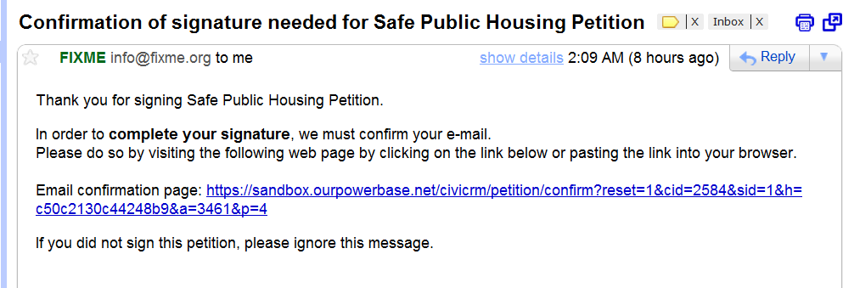

Slide 13
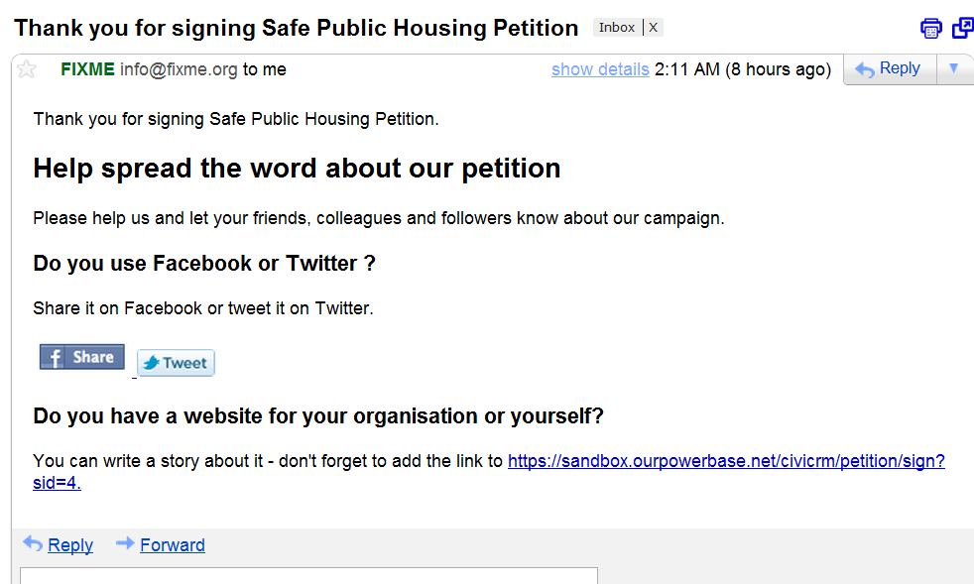

Slide 14
Questions?

Slide 15
Recording of this webinar will be posted on http://network.progressivetech.org
In 24 hours

Slide 16
Thank You!
Stay with us for Office Hours
with Josue Guillen

